Slide 1
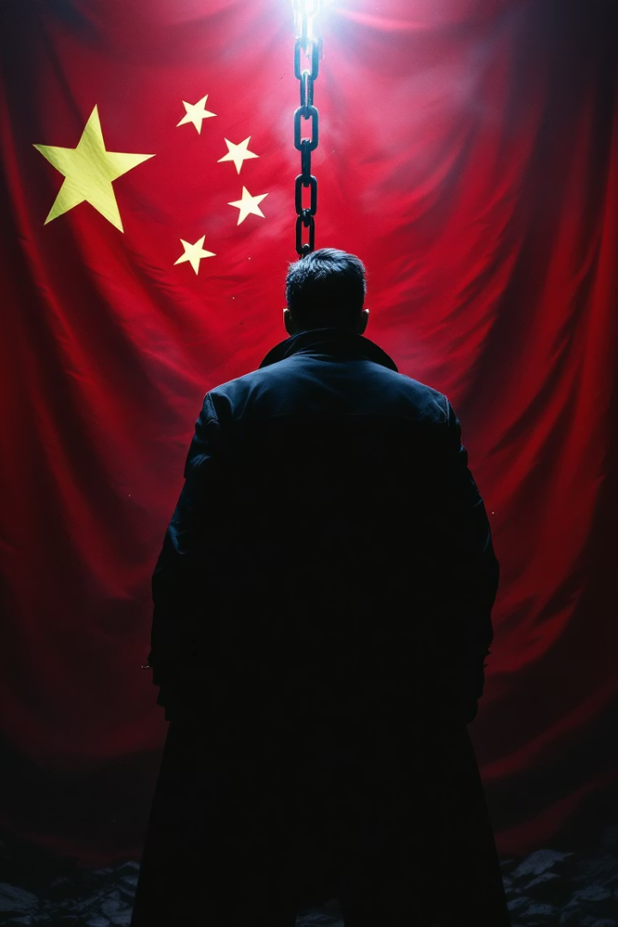
Human Rights in China
Exploring the complex landscape of human rights issues in modern China. We'll examine key concerns, government policies, and citizen resistance movements.

Slide 2

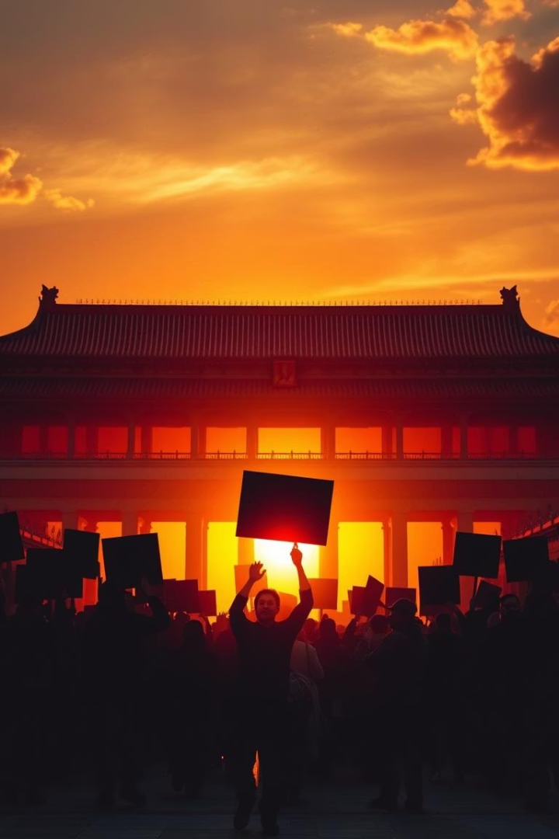






Censorship & Surveillance
The Great Firewall
World's most sophisticated internet censorship system
Press Restrictions
Ranks near bottom in global press freedom indexes
Mass Surveillance
Extensive facial recognition and monitoring technologies
Digital control extends beyond blocking websites. It shapes public discourse and limits
exposure to international perspectives.

Slide 3




Resistance Movements
Student Activism
"Stealth activism" incorporates human rights themes into art and literature.
Overseas Advocacy
Chinese students abroad organize protests supporting Tibet, Hong Kong, and Uyghurs.
Digital Resistance
Youth employ creative wordplay and coded language to discuss taboo issues.
Despite significant risks, resistance persists through increasingly creative and subtle methods.

